Slide 1

Welcome to DEBATE THAT!
Before we begin, prepare an argument for these statements (after you fill in the blank):
The best movie is ______.
The most important thing I want my students to learn is __________.
_________is the best method for solving the system:
@PiSpeak

Slide 2
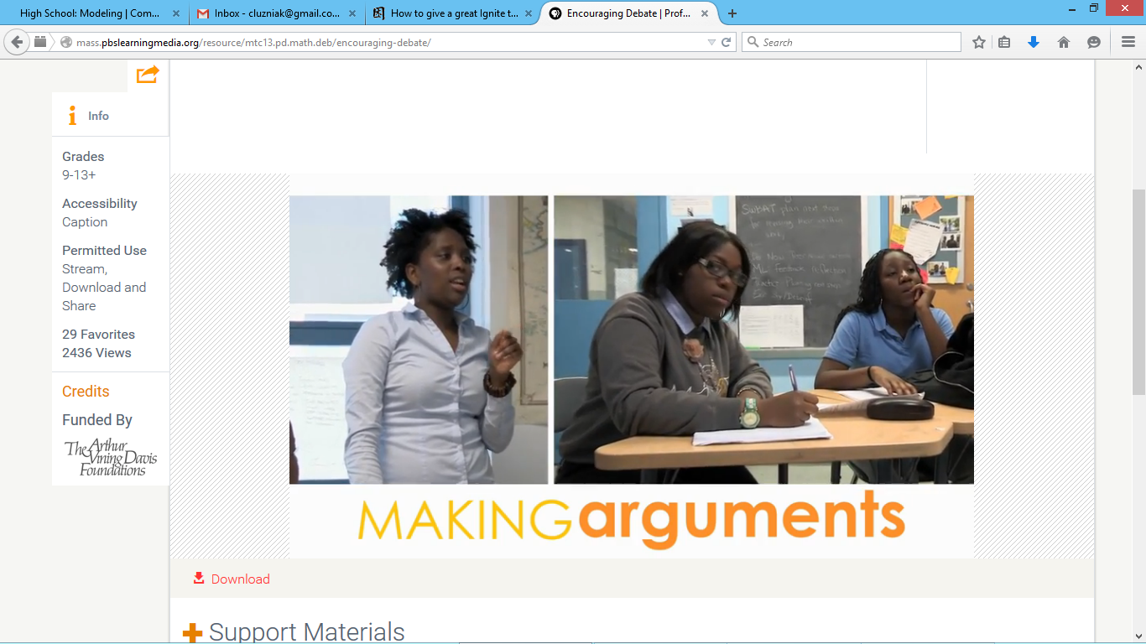
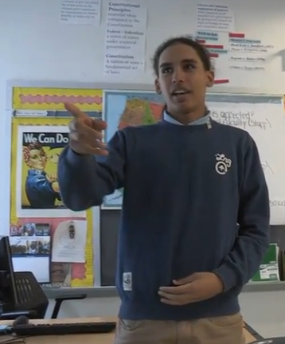
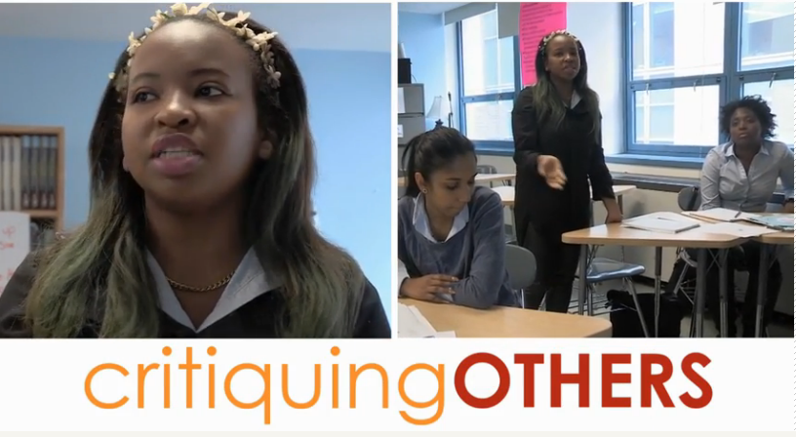
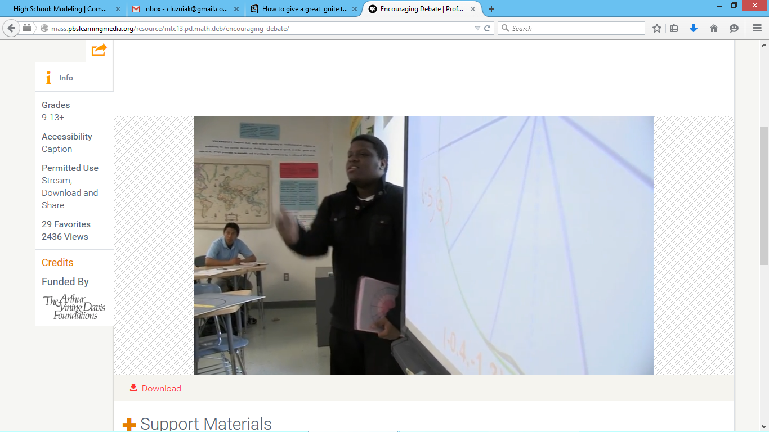

Slide 3
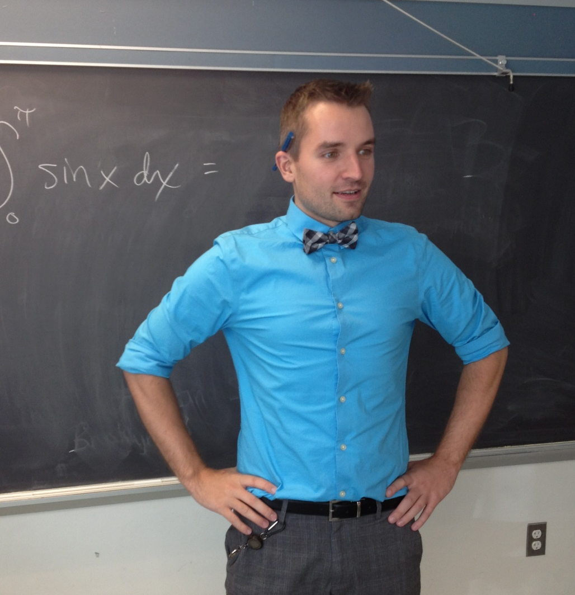

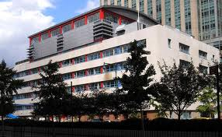
Some Introductions
Chris Luzniak
Urban Assembly School for Law & Justice
The Archer School for Girls
Notes:
And you?

Slide 4

Objectives:
To share research ideas on the benefits of debate in class.
To see the benefits by “experiencing” several debate activities.
To learn ways to introduce this in your classroom.
To create something you could use in your classroom…next week!
@PiSpeak
Notes:
STEVE
…as early as tomorrow!

Slide 5

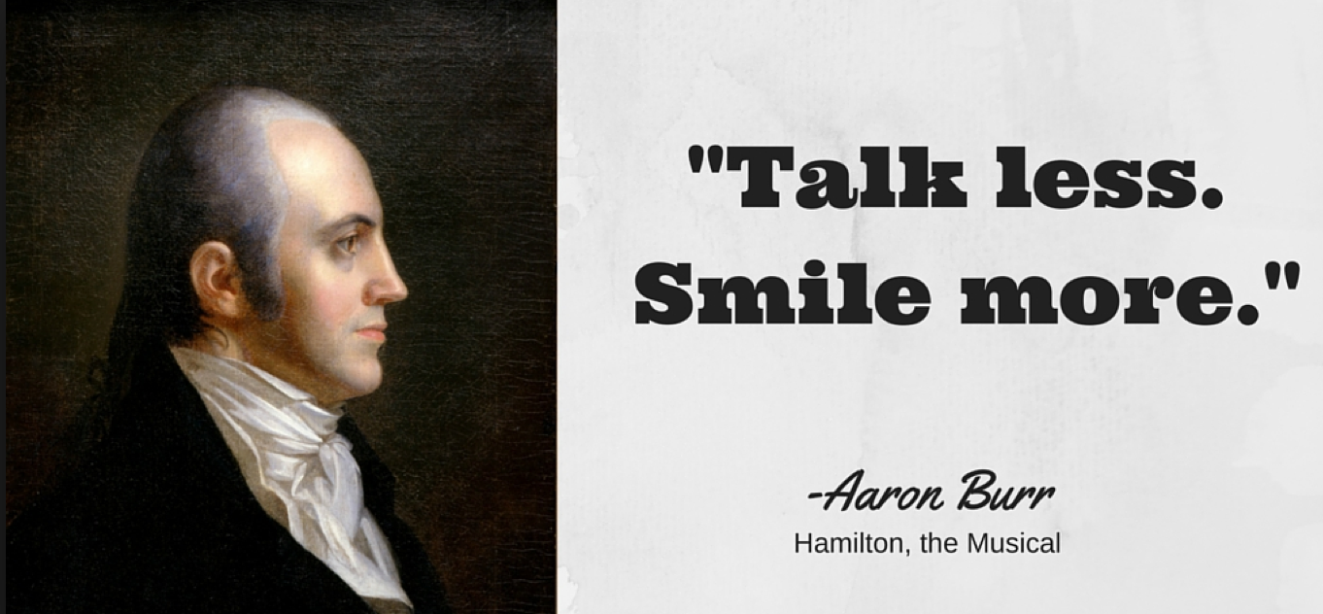

Slide 6

Why Debate?
Socratic Method
Student Centered
Critical Thinking skills
Questioning skills
Public speaking skills
Literacy skills
Rhetoric skills
Research skills
Public Speaking skills
Evidence skills
Note taking skills
Refutation skills
Critical Pedagogy Skills
Teamwork Skills
And more!
Civics
Current Events
Philosophy
Critical Theory
Humanities
Rhetoric
Political Science
Economics

Slide 7
Why Debate…in STEM?
Meaningfully Engages Large Classes
Increases student accountability
Improves test scores
Improves Graduation Rates & College Readiness
Common Core connections:
CCSS.Math.Practice.MP3 Construct viable
arguments and critique the reasoning of others.
  “students understand and use stated assumptions, definitions, and previously established results in constructing arguments…They justify their conclusions, communicate them to others, and respond to arguments of others.”
  “students try to communicate precisely to others…they have learned to examine claims and make explicit use of definitions.”

Slide 8
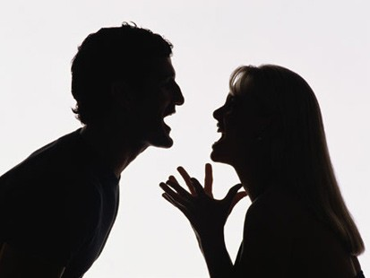
Arguments

Slide 9
ARGUMENT - a statement made with sound reasoning. Every argument has two key parts:
CLAIM - the controversial statement being made.
WARRANT - the justification for the claim.
ARGUMENT = CLAIM + WARRANT
“My CLAIM is ___________
and my WARRANT is _____________________”
@PiSpeak

Slide 10

Part 1:
Oral Arguments

Slide 11
Activity #1: Soapbox Debate
The best movie is ______.
The most important thing I want my students to learn is __________.
_________is the best method for solving the system:
“My CLAIM is ___________
and my WARRANT is _____________________”
@PiSpeak
Notes:
STEVE

Slide 12
Always, Sometimes or Never?
When you cut a piece off a shape, you reduce its area and perimeter.
Max gets a pay raise of 30%. Jim gets a pay raise of 25%. So Max gets the bigger pay raise.
@PiSpeak

Slide 13
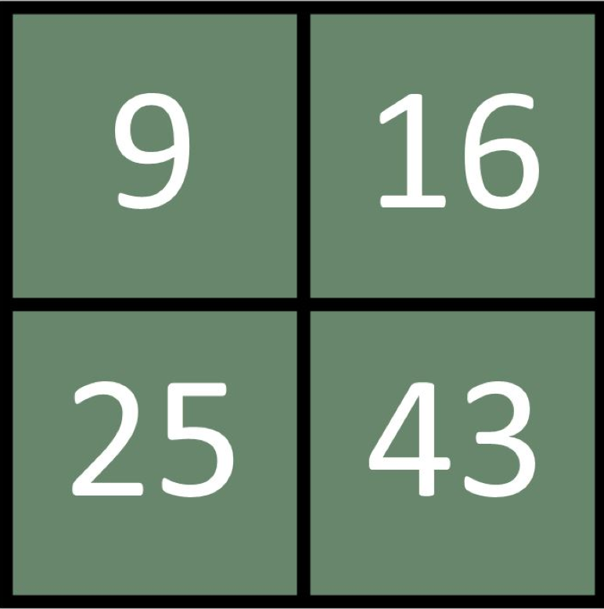
Activity #2: Circle Debate
Summarize, Claim+Warrant
@PiSpeak

Slide 14
The Best Mistake is:
@PiSpeak

Slide 15

Activity #3: Point. Counter-point.
Would you rather….(a) Have crayons for teeth
(b) Have spaghetti for hair
Would you rather solve this problem…
(a) Using a proportion
“Find 45% of 80” (b) Making into a decimal and multiplying
@PiSpeak
Notes:
STEVE

Slide 16
Activity #4: Table Debates (Debate Cards)
Problem: -8(x-15) = 64
Dividing both sides by 8 is the best first step
Using the Distributive Property is the best first step
@PiSpeak

Slide 17
Table Debates
What do you notice?
What do you wonder?

Slide 18
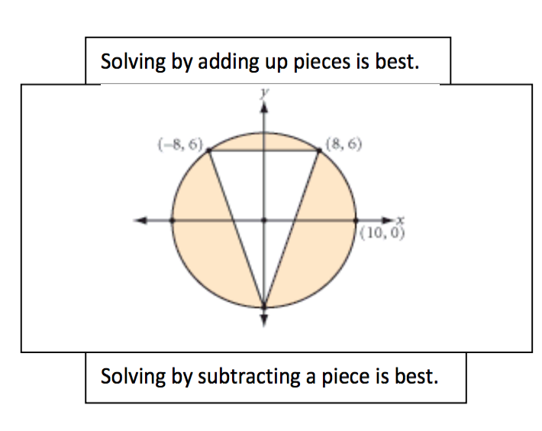
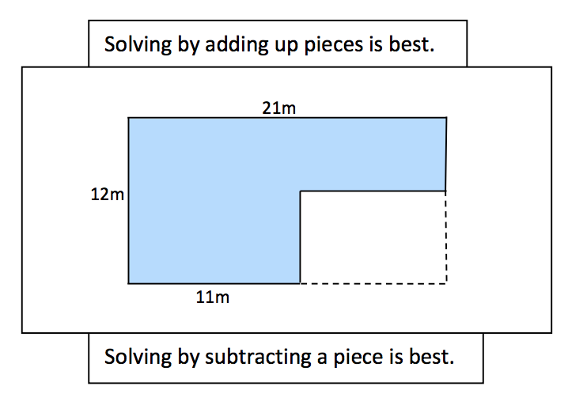
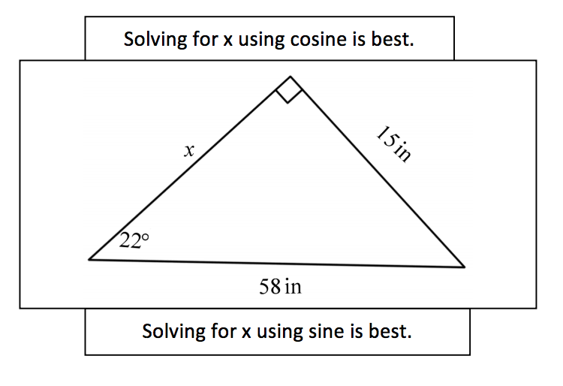
@PiSpeak

Slide 19
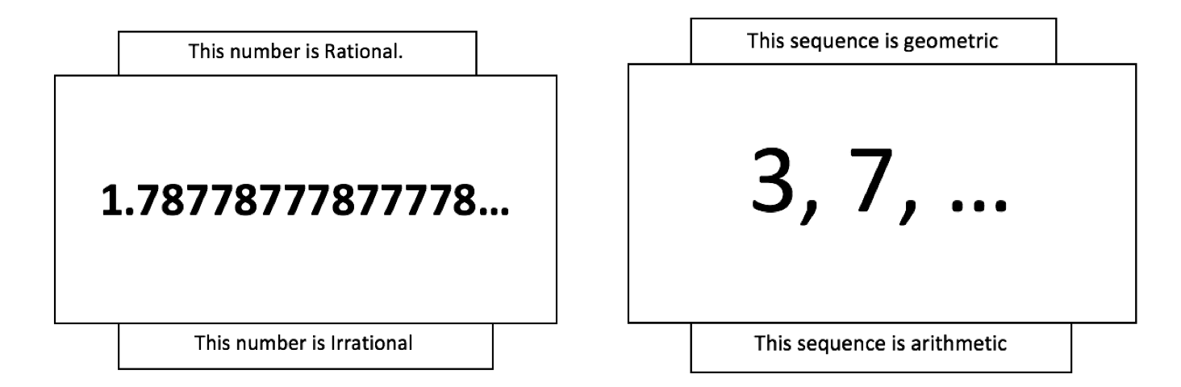
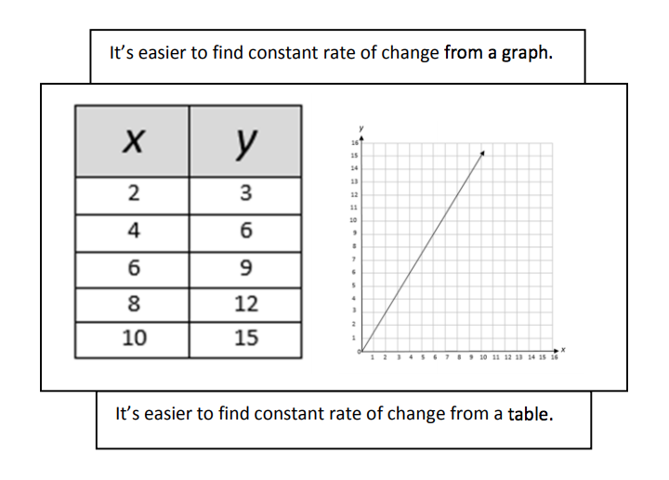
@PiSpeak

Slide 20
QUESTIONS?

Slide 21
Written Arguments

Slide 22
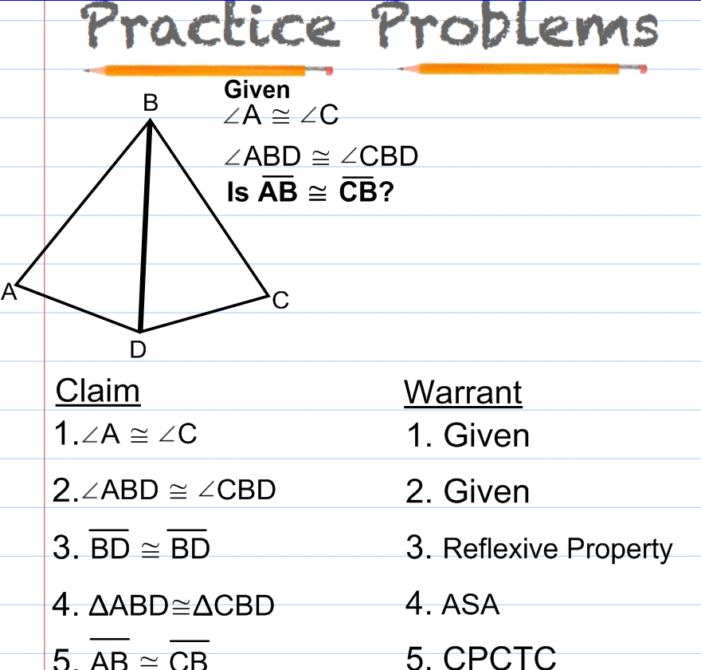
@PiSpeak

Slide 23
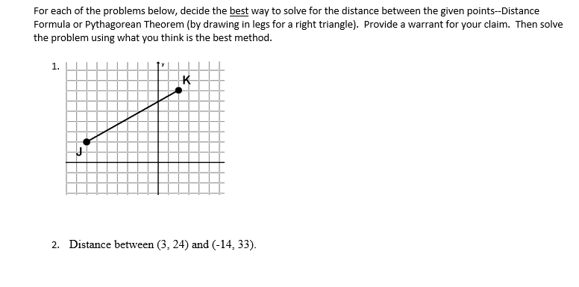
@PiSpeak

Slide 24
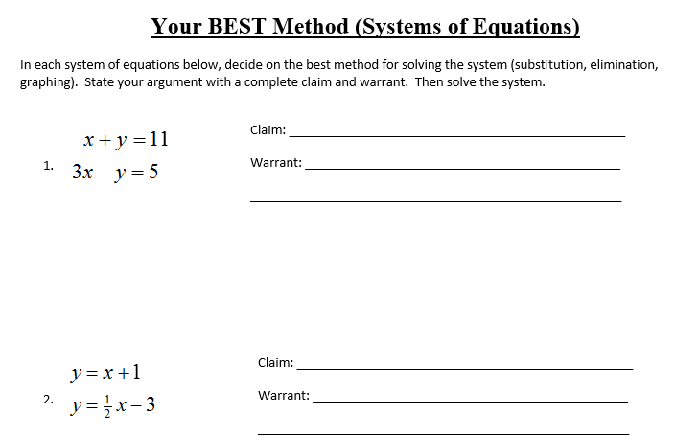
@PiSpeak

Slide 25
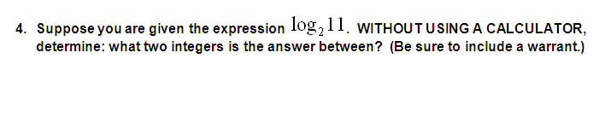
@PiSpeak

Slide 26
Part 2:
How to Start

Slide 27
Good Questions/Problems
“The more you talk about something, the deeper your understanding.”
Structure for Students
“If you want students to do x, show them how to have that experience.”
@PiSpeak

Slide 28
Structure for Students
ARGUMENT - a statement made with sound reasoning. Every argument has two key parts:
CLAIM - the controversial statement being made.
WARRANT - the justification for the claim.
@PiSpeak

Slide 29
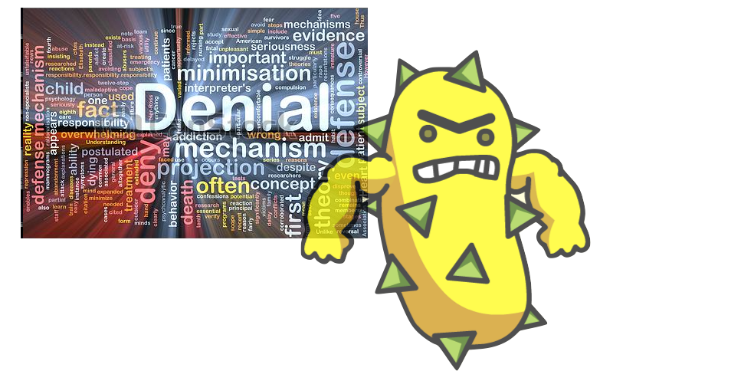
Math leads to close encounters with defense mechanisms.
We need to help students get past the “fight or flight” mentality & free them to experience the power of a growth mindset for themselves.

Slide 30
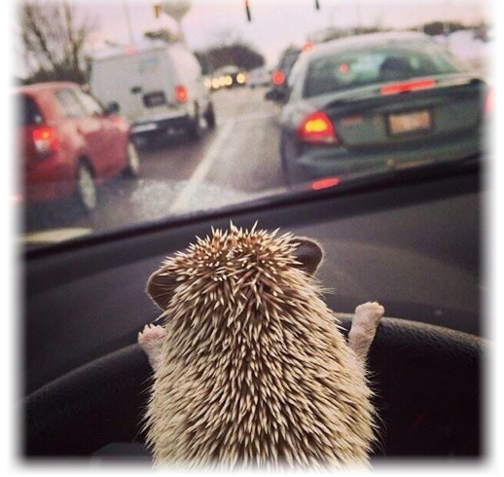
The best way to work through defense mechanisms is to Lower the Stakes...
through structures/routines/scaffolding that temporarily bracket defense mechanisms to create emotional safety.

Slide 31



Slide 32
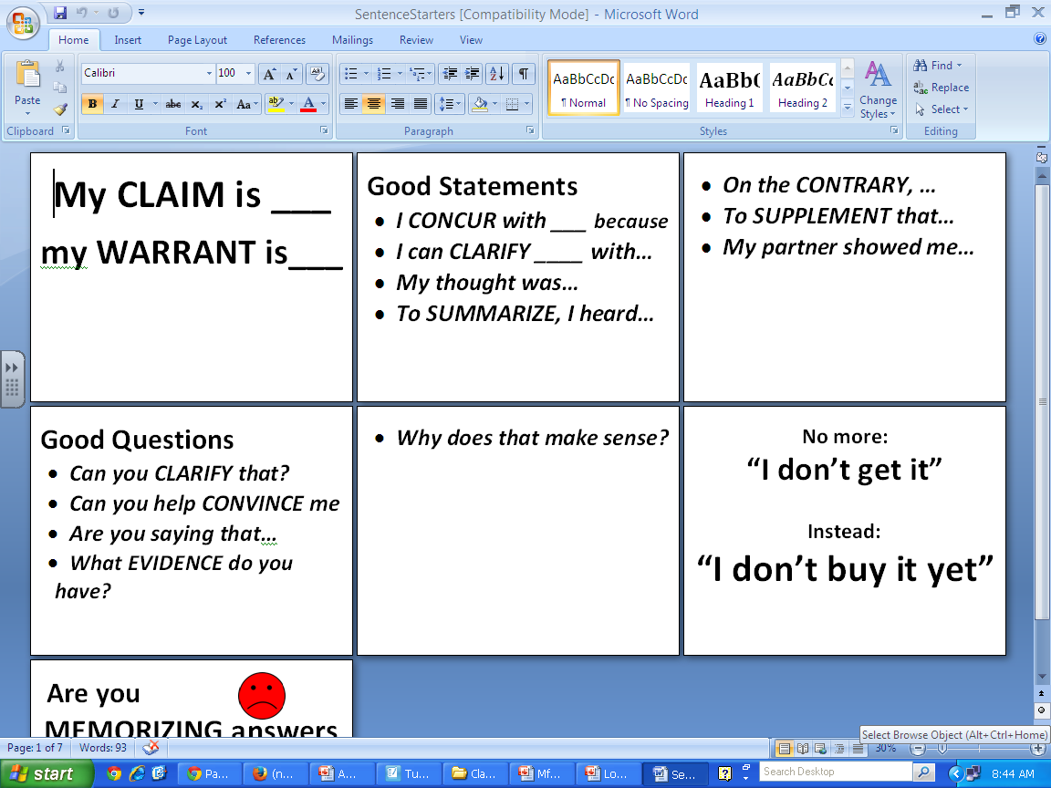

Slide 33
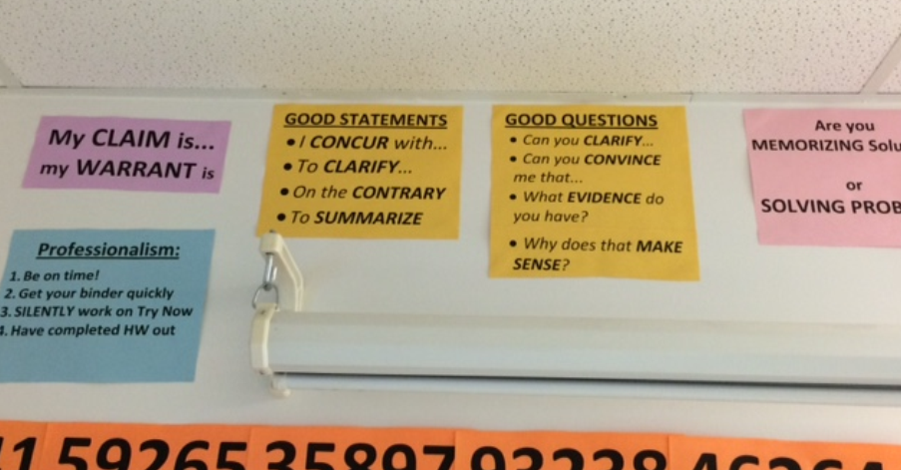
@PiSpeak

Slide 34
Good Questions/Problems
“The more you talk about something, the deeper your understanding.”
Structure for Students
“If you want students to do x, show them how to have that experience.”
@PiSpeak

Slide 35
1. Debate-y Words
Best/Worst (method, solution…)
Should
Biggest/Smallest/Most
Weirdest/Coolest
Always / Sometimes / Never
Agree / Somewhat Agree / Disagree
Using variables
@PiSpeak

Slide 36
Make it Debatable

Slide 37
Graph the function
@PiSpeak

Slide 38
The BEST way to graph a sine function is…
(For example, )
@PiSpeak

Slide 39
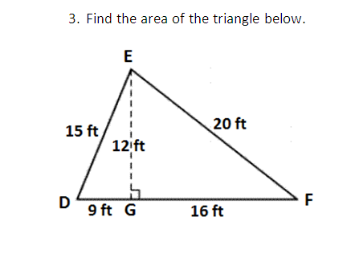
@PiSpeak

Slide 40
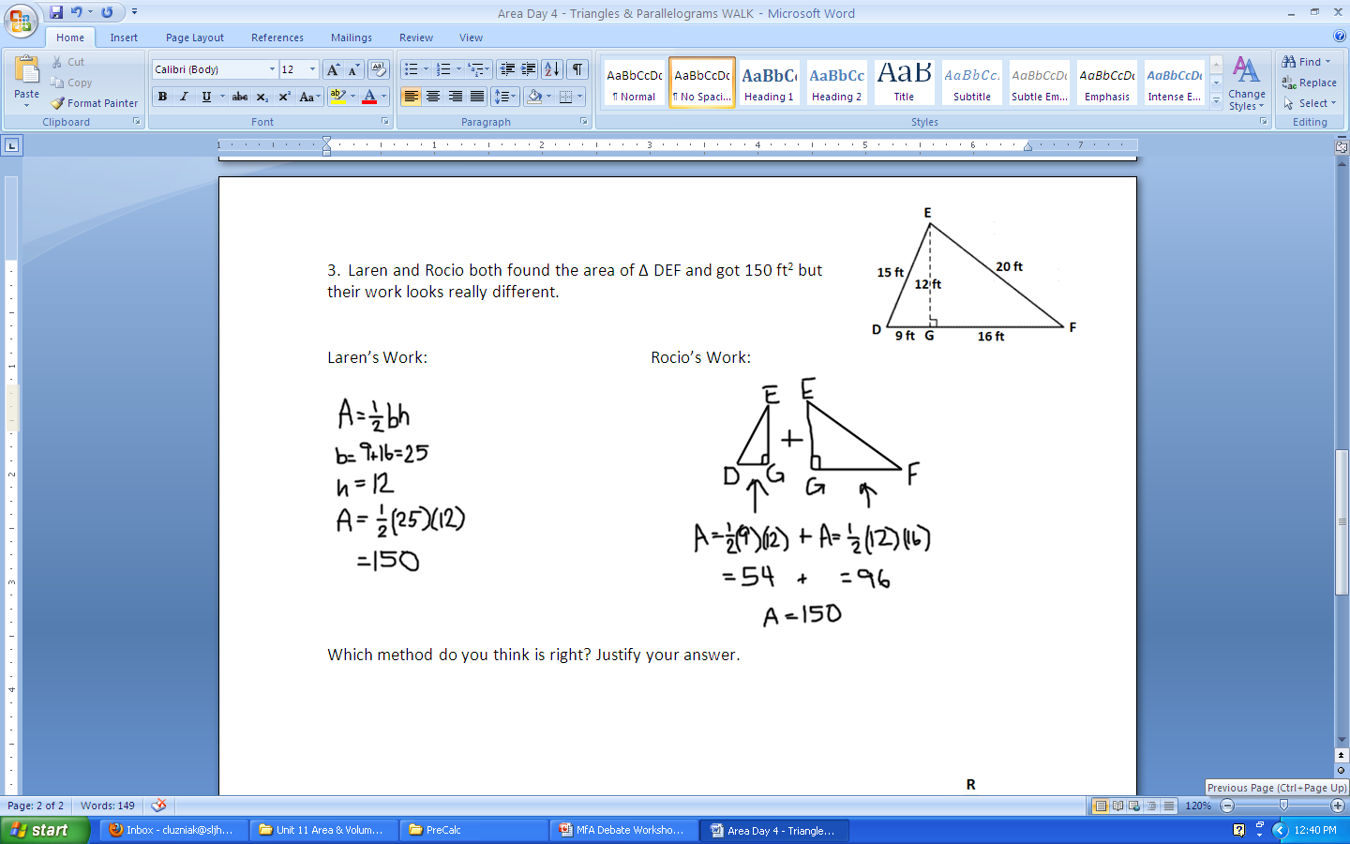

Slide 41
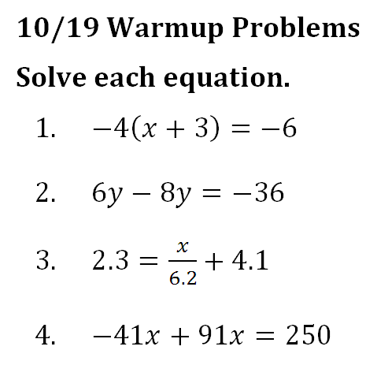
@PiSpeak

Slide 42
Part 3:
On a Larger Scale…

Slide 43
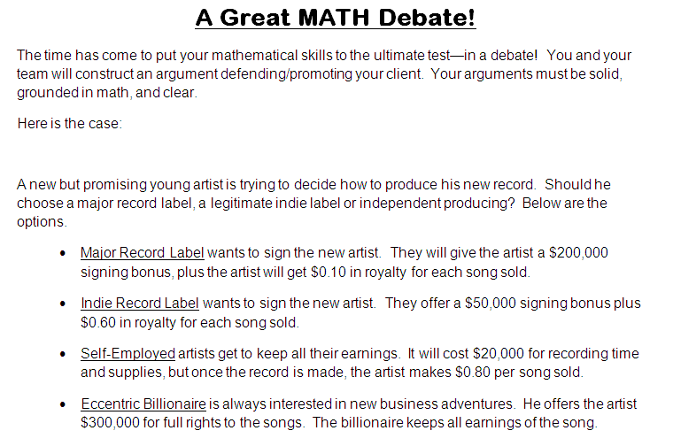
@PiSpeak

Slide 44
OPENING SPEAKER
Time: 3 minutes
QUESTION ASKER
QUESTION ANSWERER
Time: 3 minutes
ATTACKER
Time: 2 minutes
DEFENDER
Time: 2 minutes
CLOSING
Time: 2 minutes
TEAM MANAGER
@PiSpeak

Slide 45
More Examples

Slide 46
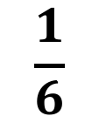
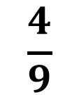
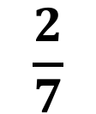
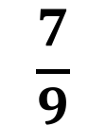
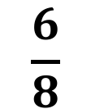
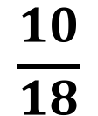
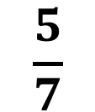
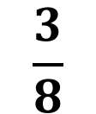
Guess My Rule
Falsification
$$\frac{7}{9}$$
$$\frac{10}{18}$$
$$\frac{3}{8}$$
$$\frac{1}{6}$$
$$\frac{6}{8}$$
$$\frac{4}{9}$$
$$\frac{2}{7}$$
$$\frac{5}{7}$$

Slide 47
Part 4:
Resources

Slide 48
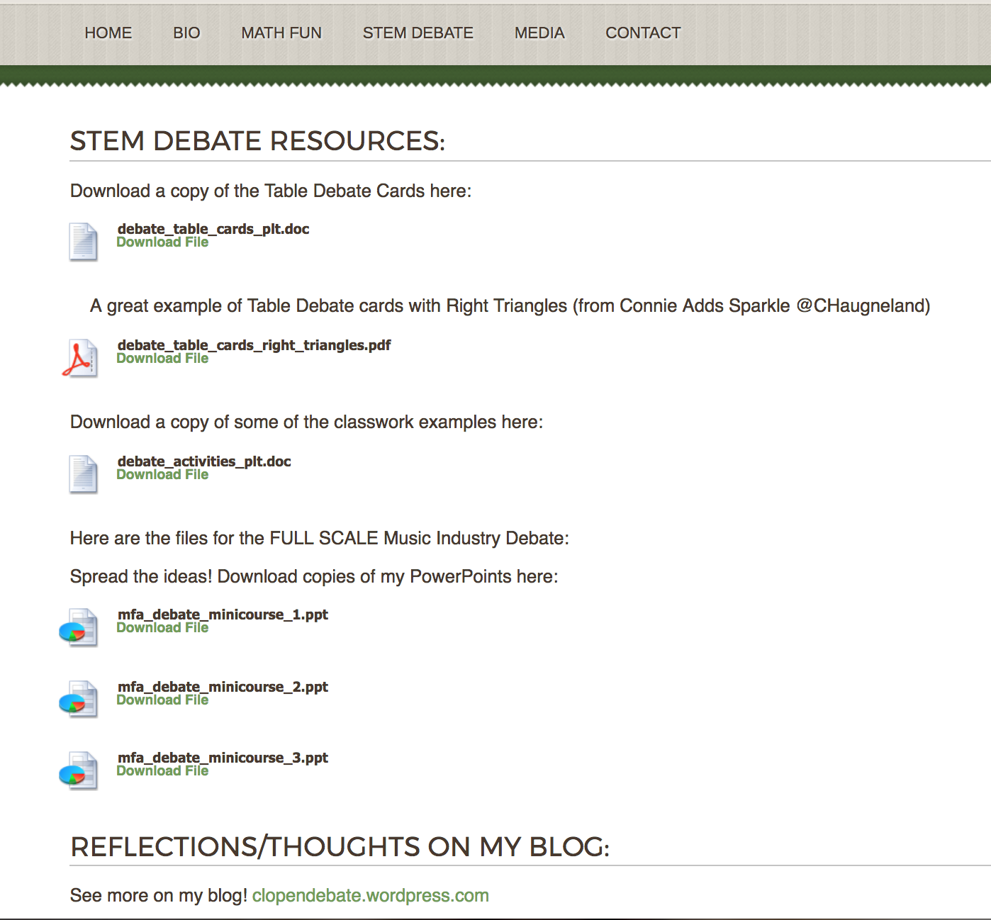

Slide 49
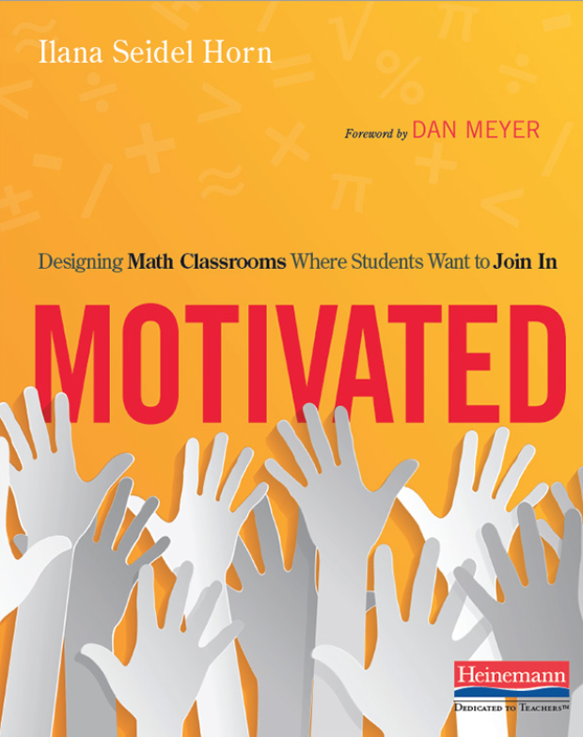

@PiSpeak

Slide 50
Thank You!
@PiSpeak
clopendebate.wordpress.com
luzniak.com
Please share your feedback on the app!

